Slide 1
DSA8301 – Stat Inference in Big Data
Lecture 1 & 2
Parametric Statistical Models

Slide 2
References
Efron, B., & Hastie, T. (2016). Computer Age Statistical Inference (Vol. 5). Cambridge University Press.
Hogg, R. V., McKean, J., & Craig, A. T. (2005). Introduction to Mathematical Statistics. Pearson Education.
Akritas, M. (2015). Probability & Statistics with R for Engineers and Scientists. Pearson Education

Slide 3
Objectives
Define statistics as a science
Define discrete and continuous parametric models
Define the exponential family of distributions
Notes:
The genetic material that carries the instructions that allow cells to make proteins
Composed of a sugar phosphate backbone from which four nitrogenous bases- adenine (A), guanine (G), cytosine (C), and thymine (T) protrude
Arranged in a double helix- two strands are held together by specific pairings between bases A – T pair and G – C pair

Slide 4
Introduction
Statistics is the science of learning from experience, particularly experience that arrives a little bit at a time: the successes and failures of a new experimental drug, the uncertain measurements of an asteroid’s path toward Earth, etc.
There are two main statistical theories: Bayesianism and frequentism.
Frequentism refers to the idea that probabilities represent long-term frequencies of repeatable random experiments.
Bayesianism assumes that parameters are random and hence follow a probability model.
Bayesians use probability to describe their incomplete knowledge of a fixed parameter, while frequentists reject the use of probability to quantify degree of belief in hypotheses.
Notes:
The genetic material that carries the instructions that allow cells to make proteins
Composed of a sugar phosphate backbone from which four nitrogenous bases- adenine (A), guanine (G), cytosine (C), and thymine (T) protrude
Arranged in a double helix- two strands are held together by specific pairings between bases A – T pair and G – C pair

Slide 5
Parametric Models and Exponential Families
The exponential family is a practically convenient and widely used unified family of distributions on finite dimensional Euclidean spaces, parametrized by a finite dimensional parameter vector.
Exponential family contains as special cases most of the standard discrete and continuous distributions that we use for practical modelling, such as the normal, Poisson, binomial, exponential, Gamma, multivariate normal, etc.
Notes:
The genetic material that carries the instructions that allow cells to make proteins
Composed of a sugar phosphate backbone from which four nitrogenous bases- adenine (A), guanine (G), cytosine (C), and thymine (T) protrude
Arranged in a double helix- two strands are held together by specific pairings between bases A – T pair and G – C pair

Slide 6
Parametric Models and Exponential Families
The exponential family is a practically convenient and widely used unified family of distributions on finite dimensional Euclidean spaces, parametrized by a finite dimensional parameter vector.
Exponential family contains as special cases most of the standard discrete and continuous distributions that we use for practical modelling, such as the normal, Poisson, binomial, exponential, Gamma, multivariate normal, etc.
Notes:
The genetic material that carries the instructions that allow cells to make proteins
Composed of a sugar phosphate backbone from which four nitrogenous bases- adenine (A), guanine (G), cytosine (C), and thymine (T) protrude
Arranged in a double helix- two strands are held together by specific pairings between bases A – T pair and G – C pair

Slide 7
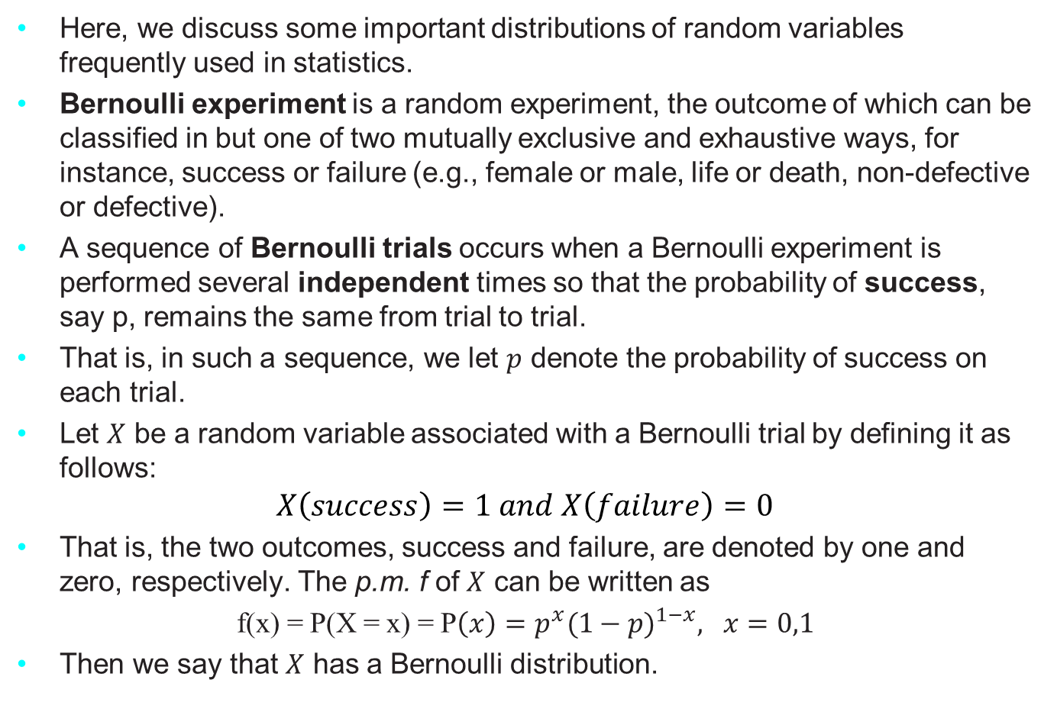
The Binomial and Related Distributions
Here, we discuss some important distributions of random variables frequently used in statistics.
Bernoulli experiment is a random experiment, the outcome of which can be classified in but one of two mutually exclusive and exhaustive ways, for instance, success or failure (e.g., female or male, life or death, non-defective or defective).
A sequence of Bernoulli trials occurs when a Bernoulli experiment is performed several independent times so that the probability of success, say p, remains the same from trial to trial.
That is, in such a sequence, we let $p$ denote the probability of success on each trial.
Let $X$ be a random variable associated with a Bernoulli trial by defining it as follows:
$$X\left(success\right)=1 and X\left(failure\right)=0$$
That is, the two outcomes, success and failure, are denoted by one and zero, respectively. The p.m. f of $X$ can be written as
f(x) = P(X = x) = P$\left(x\right)=p^{x}{(1−p)}^{1−x}, x=0,1$
Then we say that $X$ has a Bernoulli distribution.
Notes:
The genetic material that carries the instructions that allow cells to make proteins
Composed of a sugar phosphate backbone from which four nitrogenous bases- adenine (A), guanine (G), cytosine (C), and thymine (T) protrude
Arranged in a double helix- two strands are held together by specific pairings between bases A – T pair and G – C pair

Slide 8

The Binomial and Related Distributions
The mean/expected value of X is
$$μ=Ε\left(X\right)=\left(0\right)\left(1−p\right)+\left(1\right)\left(p\right)=p$$
The variance of X is
$$σ^{2}=var\left(X\right)=p^{2}\left(1−p\right)+ {(1−p)}^{2}p=p(1−p)$$
Notes:
The genetic material that carries the instructions that allow cells to make proteins
Composed of a sugar phosphate backbone from which four nitrogenous bases- adenine (A), guanine (G), cytosine (C), and thymine (T) protrude
Arranged in a double helix- two strands are held together by specific pairings between bases A – T pair and G – C pair

Slide 9
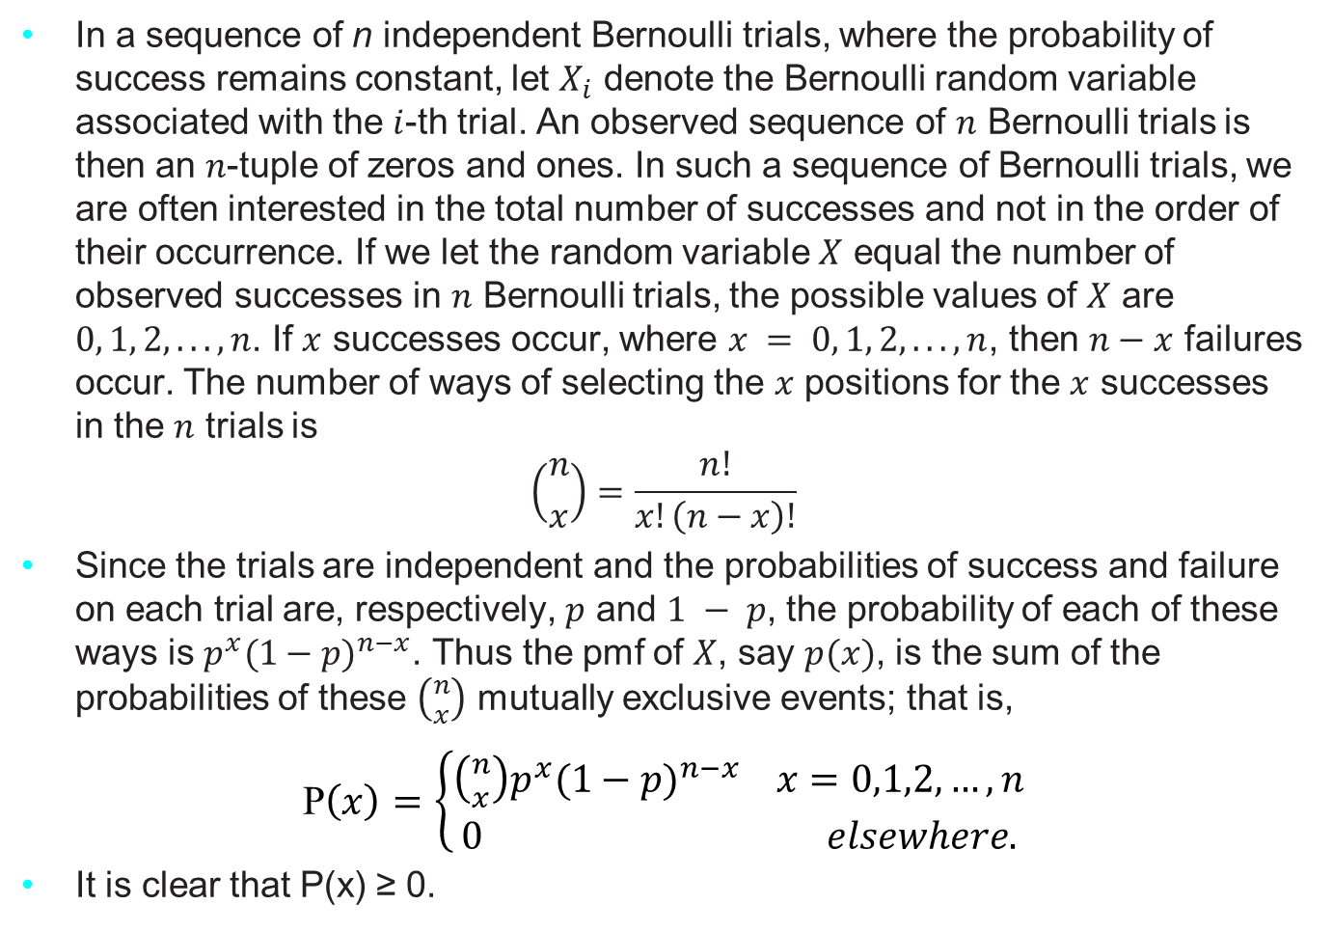
The Binomial and Related Distributions
In a sequence of n independent Bernoulli trials, where the probability of success remains constant, let $X_{i}$ denote the Bernoulli random variable associated with the $i$-th trial. An observed sequence of $n$ Bernoulli trials is then an $n$-tuple of zeros and ones. In such a sequence of Bernoulli trials, we are often interested in the total number of successes and not in the order of their occurrence. If we let the random variable $X$ equal the number of observed successes in $n$ Bernoulli trials, the possible values of $X$ are $0, 1, 2, . . . , n$. If $x$ successes occur, where $x = 0, 1, 2, . . . , n$, then $n−x$ failures occur. The number of ways of selecting the $x$ positions for the $x$ successes in the $n$ trials is
$$\left({n \atop x}\right)=\frac{n!}{x!\left(n−x\right)!}$$
Since the trials are independent and the probabilities of success and failure on each trial are, respectively, $p$ and $1 − p$, the probability of each of these ways is $p^{x}{(1−p)}^{n−x}$. Thus the pmf of $X$, say $p(x)$, is the sum of the probabilities of these $\left({n \atop x}\right)$ mutually exclusive events; that is,
P$\left(x\right)=\left\{\begin{aligned}\left({n \atop x}\right)p^{x}{(1−p)}^{n−x} x=0,1,2, …, n \\ 0 elsewhere.\end{aligned}\right.$
It is clear that P(x) ≥ 0.
Notes:
The genetic material that carries the instructions that allow cells to make proteins
Composed of a sugar phosphate backbone from which four nitrogenous bases- adenine (A), guanine (G), cytosine (C), and thymine (T) protrude
Arranged in a double helix- two strands are held together by specific pairings between bases A – T pair and G – C pair

Slide 10
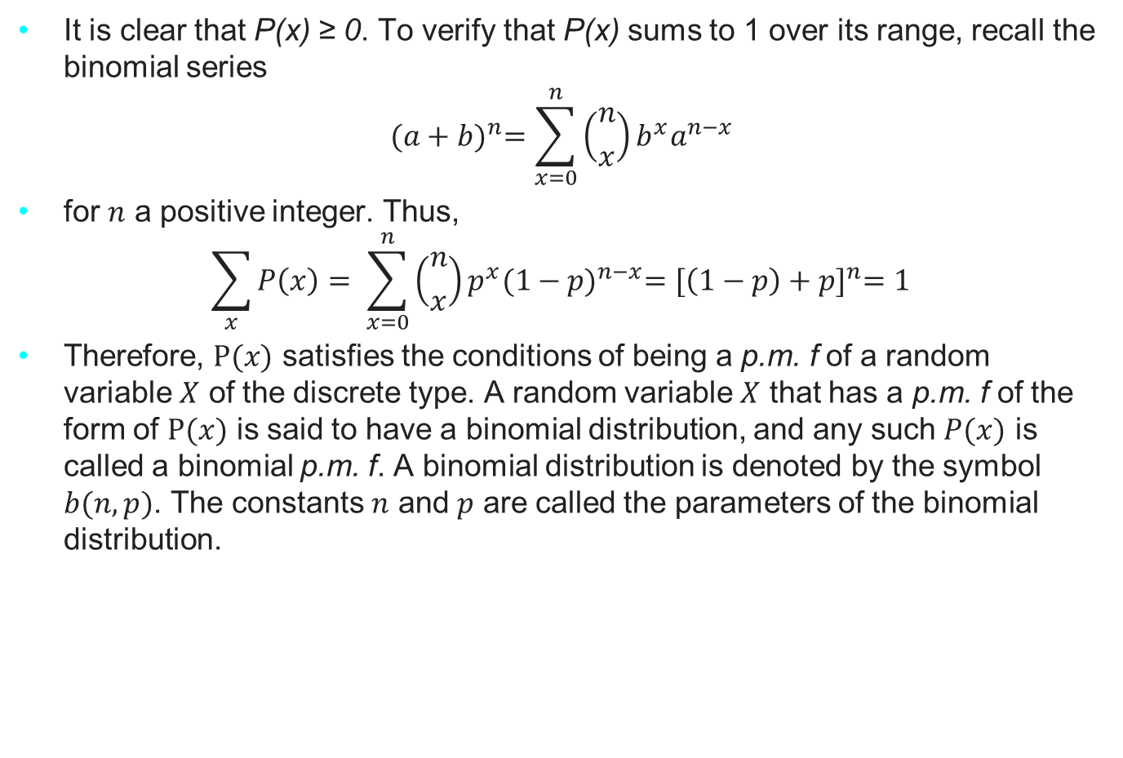
The Binomial and Related Distributions
It is clear that P(x) ≥ 0. To verify that P(x) sums to 1 over its range, recall the binomial series
$${(a+b)}^{n}=\sum_{x=0}^{n}{\left({n \atop x}\right)}b^{x}a^{n−x}$$
for $n$ a positive integer. Thus,
$$\sum_{x}{P\left(x\right)= \sum_{x=0}^{n}{\left({n \atop x}\right)}p^{x}{(1−p)}^{n−x}={[\left(1−p\right)+p]}^{n}=1}$$
Therefore, $P(x)$ satisfies the conditions of being a p.m. f of a random variable $X$ of the discrete type. A random variable $X$ that has a p.m. f of the form of $P(x)$ is said to have a binomial distribution, and any such $P(x)$ is called a binomial p.m. f. A binomial distribution is denoted by the symbol $b(n, p)$. The constants $n$ and $p$ are called the parameters of the binomial distribution.
Notes:
The genetic material that carries the instructions that allow cells to make proteins
Composed of a sugar phosphate backbone from which four nitrogenous bases- adenine (A), guanine (G), cytosine (C), and thymine (T) protrude
Arranged in a double helix- two strands are held together by specific pairings between bases A – T pair and G – C pair

Slide 11
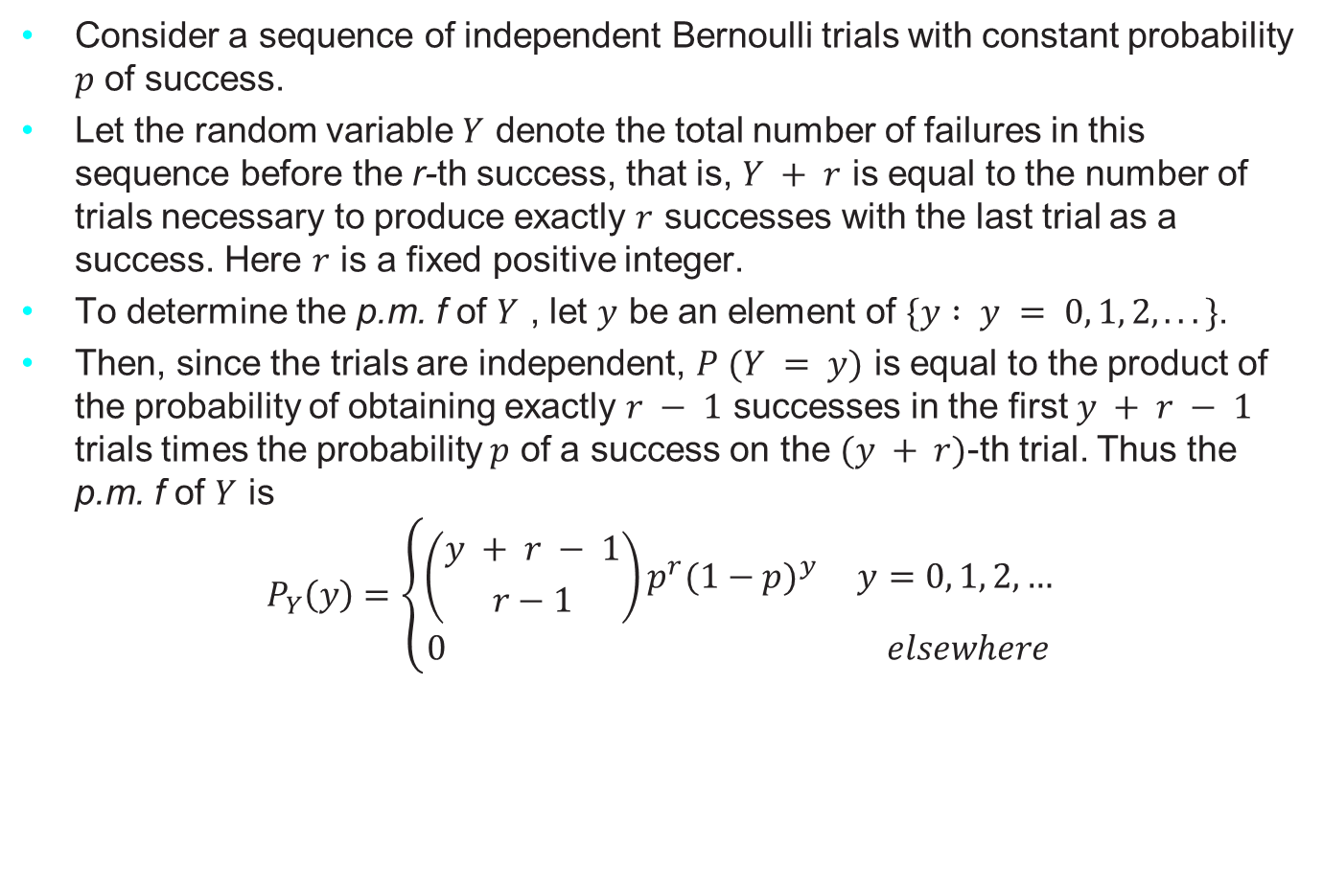
Negative Binomial and Geometric Distributions
Consider a sequence of independent Bernoulli trials with constant probability $p$ of success.
Let the random variable $Y$ denote the total number of failures in this sequence before the r-th success, that is, $Y + r$ is equal to the number of trials necessary to produce exactly $r$ successes with the last trial as a success. Here $r$ is a fixed positive integer.
To determine the p.m. f of $Y$ , let $y$ be an element of $\{y : y = 0, 1, 2, . . .\}$.
Then, since the trials are independent, $P (Y = y)$ is equal to the product of the probability of obtaining exactly $r − 1$ successes in the first $y + r − 1$ trials times the probability $p$ of a success on the $(y + r)$-th trial. Thus the p.m. f of $Y$ is
$$P_{Y}\left(y\right)=\left\{\begin{aligned}\left({y + r − 1 \atop r−1}\right)p^{r}{(1−p)}^{y} y=0, 1, 2, … \\ 0 elsewhere\end{aligned}\right.$$
Notes:
The genetic material that carries the instructions that allow cells to make proteins
Composed of a sugar phosphate backbone from which four nitrogenous bases- adenine (A), guanine (G), cytosine (C), and thymine (T) protrude
Arranged in a double helix- two strands are held together by specific pairings between bases A – T pair and G – C pair

Slide 12
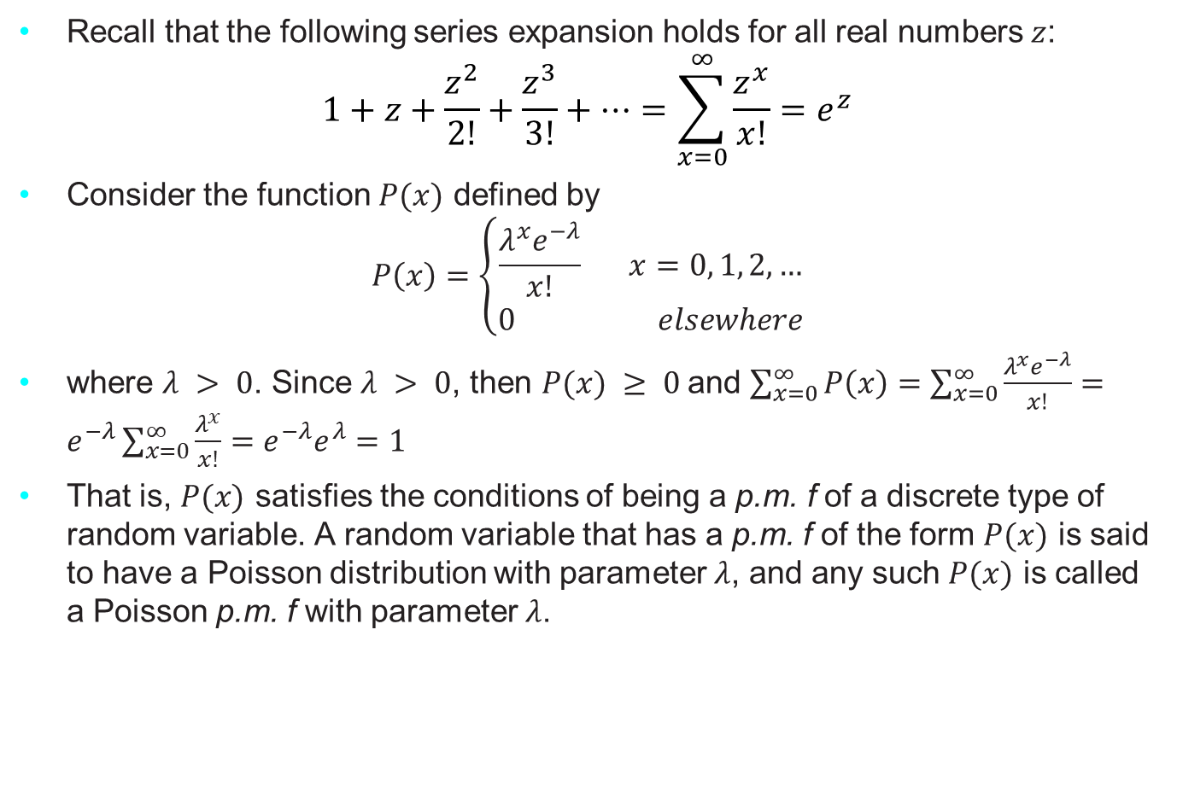
The Poisson Distribution
Recall that the following series expansion holds for all real numbers $z$:
$$1+z+\frac{z^{2}}{2!}+\frac{z^{3}}{3!}+…=\sum_{x=0}^{∞}{\frac{z^{x}}{x!}=e^{z}}$$
Consider the function $P(x)$ defined by
$$P\left(x\right)=\left\{\begin{aligned}\frac{λ^{x}e^{−λ}}{x!} x=0, 1, 2, … \\ 0 elsewhere\end{aligned}\right.$$
where $λ > 0$. Since $λ > 0$, then $P(x) ≥ 0$and $\sum_{x=0}^{∞}{P\left(x\right)=\sum_{x=0}^{∞}{\frac{λ^{x}e^{−λ}}{x!}}}=e^{−λ}\sum_{x=0}^{∞}{\frac{λ^{x}}{x!}}=e^{−λ}e^{λ}=1$
That is, $P(x)$ satisfies the conditions of being a p.m. f of a discrete type of random variable. A random variable that has a p.m. f of the form $P(x)$ is said to have a Poisson distribution with parameter $λ$, and any such $P(x)$ is called a Poisson p.m. f with parameter $λ$.
Notes:
The genetic material that carries the instructions that allow cells to make proteins
Composed of a sugar phosphate backbone from which four nitrogenous bases- adenine (A), guanine (G), cytosine (C), and thymine (T) protrude
Arranged in a double helix- two strands are held together by specific pairings between bases A – T pair and G – C pair

Slide 13
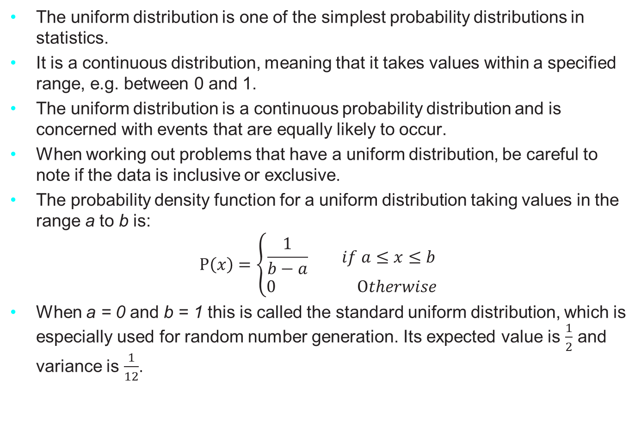
The Uniform Distribution
The uniform distribution is one of the simplest probability distributions in statistics.
It is a continuous distribution, meaning that it takes values within a specified range, e.g. between 0 and 1.
The uniform distribution is a continuous probability distribution and is concerned with events that are equally likely to occur.
When working out problems that have a uniform distribution, be careful to note if the data is inclusive or exclusive.
The probability density function for a uniform distribution taking values in the range a to b is:
$$P\left(x\right)=\left\{\begin{aligned}\frac{1}{b−a} if a≤x≤b \\ 0 Otherwise\end{aligned}\right.$$
When a = 0 and b = 1 this is called the standard uniform distribution, which is especially used for random number generation. Its expected value is $\frac{1}{2}$ and variance is $\frac{1}{12}$.
Notes:
The genetic material that carries the instructions that allow cells to make proteins
Composed of a sugar phosphate backbone from which four nitrogenous bases- adenine (A), guanine (G), cytosine (C), and thymine (T) protrude
Arranged in a double helix- two strands are held together by specific pairings between bases A – T pair and G – C pair

Slide 14

The Uniform Distribution
The uniform distribution (discrete) is one of the simplest probability distributions in statistics. It is a discrete distribution, meaning that it takes a finite set of possible, e.g. 1, 2, 3, 4, 5 and 6.
The probability mass function for a uniform distribution taking one of n possible values from the set $A = (x_{1}, …, x_{n})$ is:
P$\left(x\right)=\left\{\begin{aligned}\frac{1}{n} if x∈A \\ 0 otherwise\end{aligned}\right.$
Notes:
The genetic material that carries the instructions that allow cells to make proteins
Composed of a sugar phosphate backbone from which four nitrogenous bases- adenine (A), guanine (G), cytosine (C), and thymine (T) protrude
Arranged in a double helix- two strands are held together by specific pairings between bases A – T pair and G – C pair

Slide 15
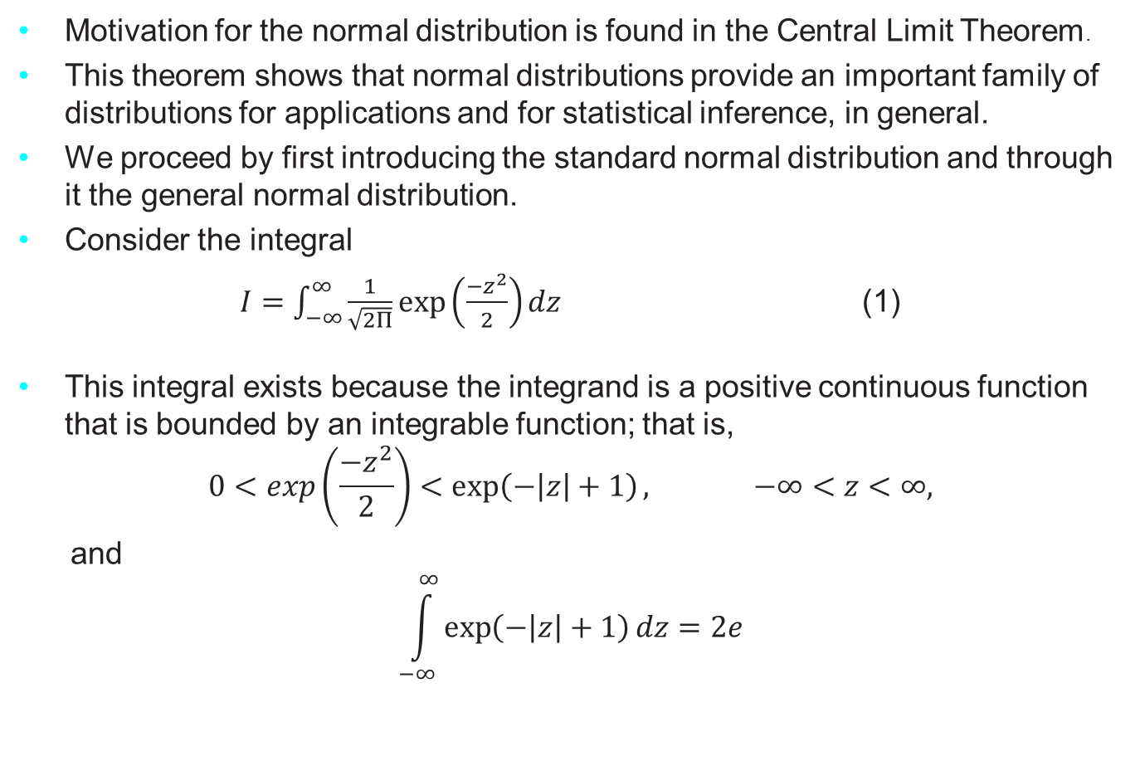
The Normal Distribution
Motivation for the normal distribution is found in the Central Limit Theorem.
This theorem shows that normal distributions provide an important family of distributions for applications and for statistical inference, in general.
We proceed by first introducing the standard normal distribution and through it the general normal distribution.
Consider the integral
$I=\int_{−∞}^{∞}{\frac{1}{\sqrt{2Π}}exp⁡\left(\frac{{−z}^{2}}{2}\right)}dz$ (1)
This integral exists because the integrand is a positive continuous function that is bounded by an integrable function; that is,
$$0<exp\left(\frac{{−z}^{2}}{2}\right)<\exp\left(−\left|z\right|+1\right), −∞<z<∞,$$
and
$$\int_{−∞}^{∞}{\exp\left(−\left|z\right|+1\right)}dz=2e$$
Notes:
The genetic material that carries the instructions that allow cells to make proteins
Composed of a sugar phosphate backbone from which four nitrogenous bases- adenine (A), guanine (G), cytosine (C), and thymine (T) protrude
Arranged in a double helix- two strands are held together by specific pairings between bases A – T pair and G – C pair

Slide 16
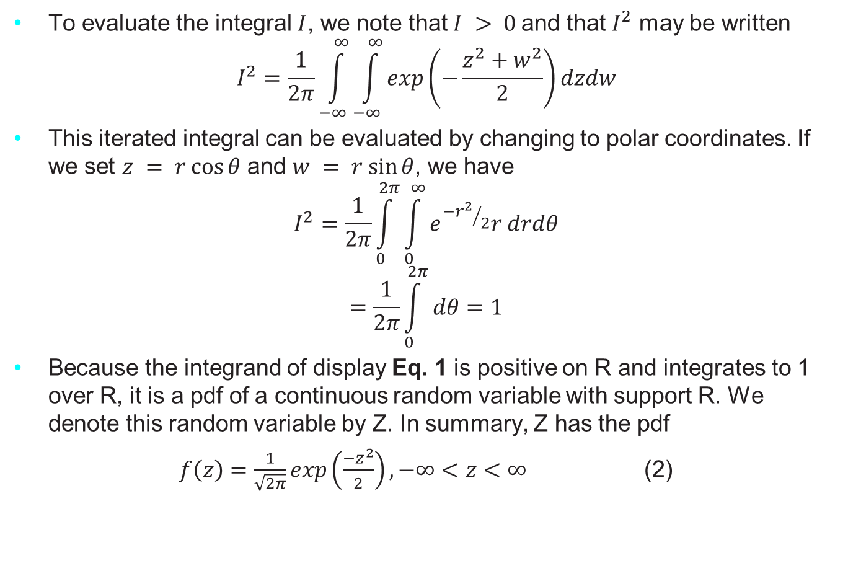
The Normal Distribution
To evaluate the integral $I$, we note that $I > 0$and that $I^{2}$ may be written
$$I^{2}=\frac{1}{2π}\int_{−∞}^{∞}{\int_{−∞}^{∞}{exp\left(−\frac{z^{2}+w^{2}}{2}\right)}}dzdw$$
This iterated integral can be evaluated by changing to polar coordinates. If we set $z = r cos⁡θ$ and $w = r sin⁡θ$, we have
$$I^{2}=\frac{1}{2π}\int_{0}^{2π}{\int_{0}^{∞}{e^{{−r^{2}}/2}r drdθ}}$$
$$=\frac{1}{2π}\int_{0}^{2π}{dθ=1}$$
Because the integrand of display Eq. 1 is positive on R and integrates to 1 over R, it is a pdf of a continuous random variable with support R. We denote this random variable by Z. In summary, Z has the pdf
$f\left(z\right)=\frac{1}{\sqrt{2π}}exp\left(\frac{−z^{2}}{2}\right), −∞<z<∞$ (2)
Notes:
The genetic material that carries the instructions that allow cells to make proteins
Composed of a sugar phosphate backbone from which four nitrogenous bases- adenine (A), guanine (G), cytosine (C), and thymine (T) protrude
Arranged in a double helix- two strands are held together by specific pairings between bases A – T pair and G – C pair

Slide 17
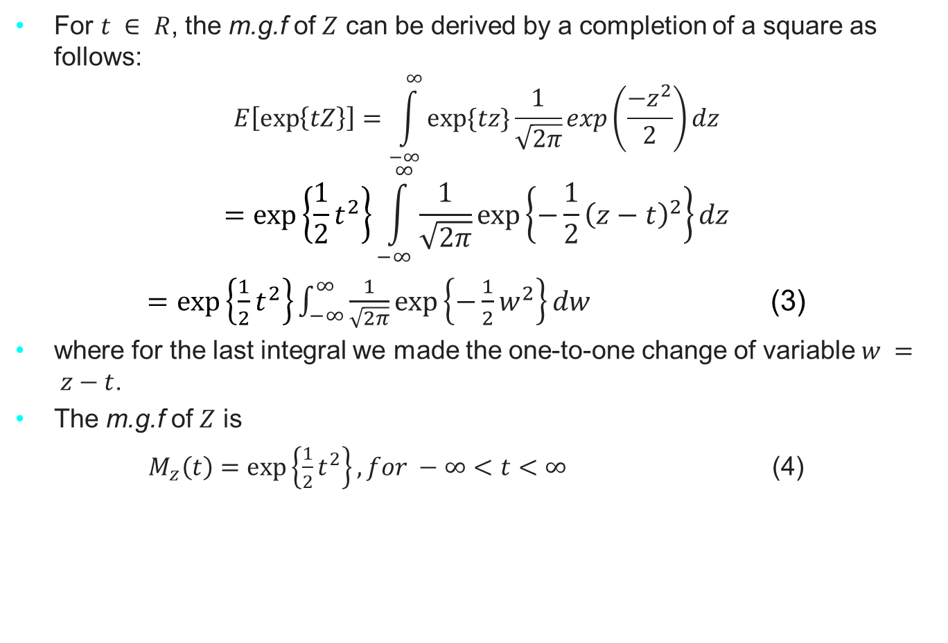
The Normal Distribution
For $t ∈ R$, the m.g.f of $Z$ can be derived by a completion of a square as follows:
$$E\left[\exp\left\{tZ\right\}\right]=\int_{−∞}^{∞}{exp⁡\{tz\}\frac{1}{\sqrt{2π}}exp\left(\frac{−z^{2}}{2}\right)dz}$$
$$=exp⁡\left\{\frac{1}{2}t^{2}\right\}\int_{−∞}^{∞}{\frac{1}{\sqrt{2π}}\exp\left\{−\frac{1}{2}{\left(z−t\right)}^{2}\right\}dz}$$
$=exp⁡\left\{\frac{1}{2}t^{2}\right\}\int_{−∞}^{∞}{\frac{1}{\sqrt{2π}}\exp\left\{−\frac{1}{2}w^{2}\right\}dw}$ (3)
where for the last integral we made the one-to-one change of variable $w = z−t$.
The m.g.f of $Z$ is
$M_{z}\left(t\right)=\exp\left\{\frac{1}{2}t^{2}\right\}, for −∞<t<∞$ (4)
Notes:
The genetic material that carries the instructions that allow cells to make proteins
Composed of a sugar phosphate backbone from which four nitrogenous bases- adenine (A), guanine (G), cytosine (C), and thymine (T) protrude
Arranged in a double helix- two strands are held together by specific pairings between bases A – T pair and G – C pair

Slide 18
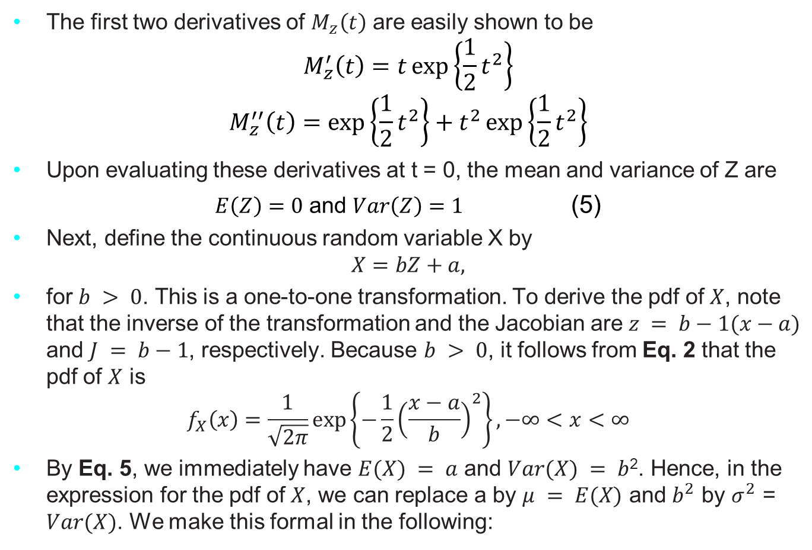
The Normal Distribution
The first two derivatives of $M_{z}\left(t\right)$ are easily shown to be
$$M_{z}^{′}\left(t\right)=t\exp\left\{\frac{1}{2}t^{2}\right\}$$
$$M_{z}^{′′}\left(t\right)=\exp\left\{\frac{1}{2}t^{2}\right\}+t^{2}\exp\left\{\frac{1}{2}t^{2}\right\}$$
Upon evaluating these derivatives at t = 0, the mean and variance of Z are
$E\left(Z\right)=0$ and $Var\left(Z\right)=1$ (5)
Next, define the continuous random variable X by
$$X=bZ+a,$$
for $b > 0$. This is a one-to-one transformation. To derive the pdf of $X$, note that the inverse of the transformation and the Jacobian are $z = b−1(x−a)$ and $J = b−1$, respectively. Because $b > 0$, it follows from Eq. 2 that the pdf of $X$ is
$$f_{X}\left(x\right)=\frac{1}{\sqrt{2π}}\exp\left\{−\frac{1}{2}{\left(\frac{x−a}{b}\right)}^{2}\right\}, −∞<x<∞$$
By Eq. 5, we immediately have $E(X) = a$ and $Var(X) = b$². Hence, in the expression for the pdf of $X$, we can replace a by $μ = E(X)$ and $b^{2}$ by $σ^{2}$ = $Var(X)$. We make this formal in the following:
Notes:
The genetic material that carries the instructions that allow cells to make proteins
Composed of a sugar phosphate backbone from which four nitrogenous bases- adenine (A), guanine (G), cytosine (C), and thymine (T) protrude
Arranged in a double helix- two strands are held together by specific pairings between bases A – T pair and G – C pair

Slide 19

The Exponential Distribution
The exponential distribution is one of the widely used continuous distributions.
It is often used to model the time elapsed between events.
A continuous random variable $X$ is said to have an exponential distribution with parameter $λ>0$, shown as $X∼Exponential(λ)$, if its p.d.f is given by
$$f_{X}\left(x\right)=\left\{\begin{aligned}λe^{−λx} x>0 \\ 0 Otherwise\end{aligned}\right.$$
Notes:
The genetic material that carries the instructions that allow cells to make proteins
Composed of a sugar phosphate backbone from which four nitrogenous bases- adenine (A), guanine (G), cytosine (C), and thymine (T) protrude
Arranged in a double helix- two strands are held together by specific pairings between bases A – T pair and G – C pair

Slide 20
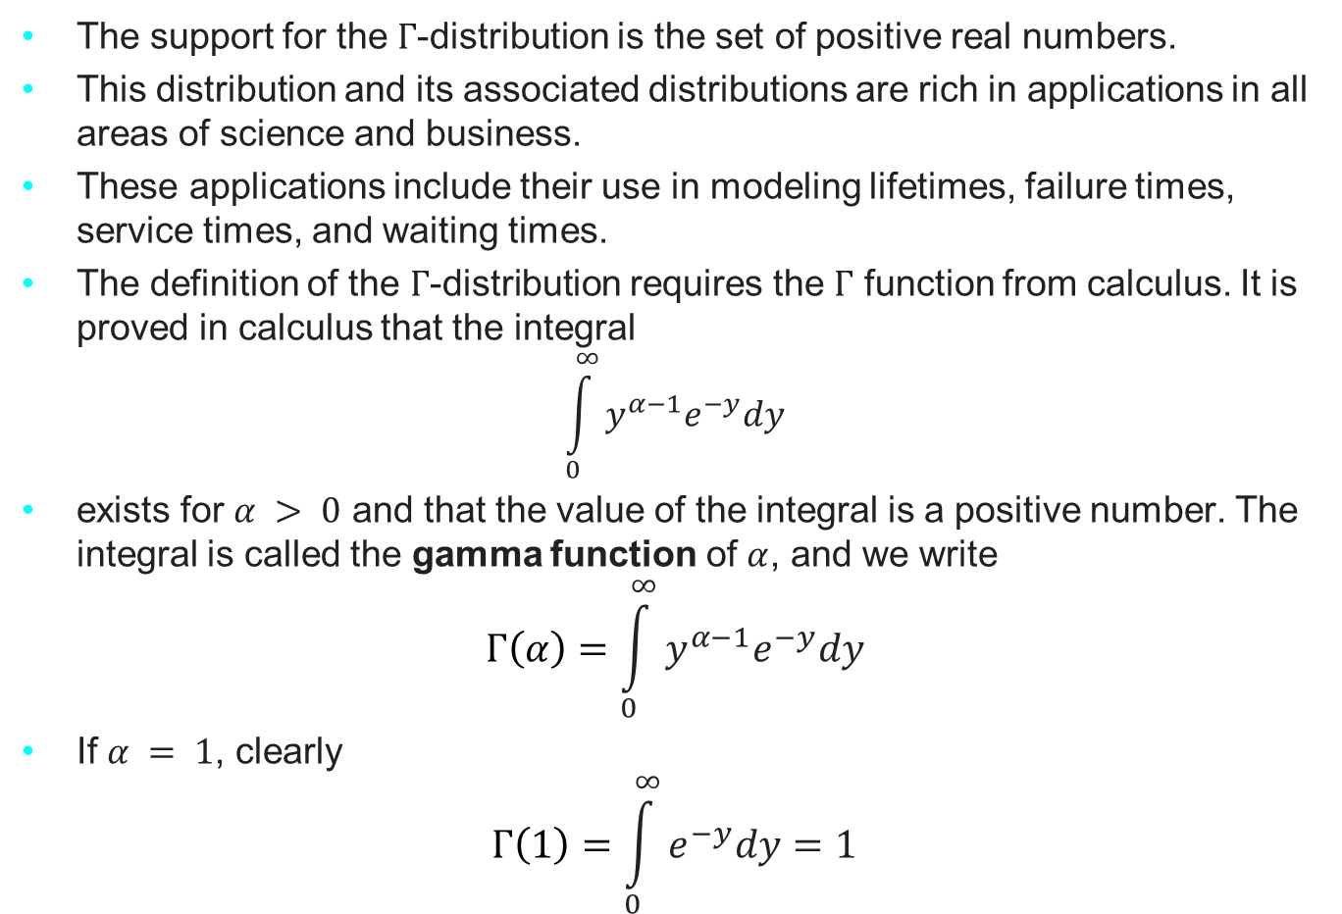
The Gamma ($Γ$) Distribution
The support for the $Γ$-distribution is the set of positive real numbers.
This distribution and its associated distributions are rich in applications in all areas of science and business.
These applications include their use in modeling lifetimes, failure times, service times, and waiting times.
The definition of the $Γ$-distribution requires the $Γ$ function from calculus. It is proved in calculus that the integral
$$\int_{0}^{∞}{y^{α−1}e^{−y}dy}$$
exists for $α > 0$ and that the value of the integral is a positive number. The integral is called the gamma function of $α$, and we write
$$Γ\left(α\right)=\int_{0}^{∞}{y^{α−1}e^{−y}dy}$$
If $α = 1$, clearly
$$Γ\left(1\right)=\int_{0}^{∞}{e^{−y}dy=1}$$
Notes:
The genetic material that carries the instructions that allow cells to make proteins
Composed of a sugar phosphate backbone from which four nitrogenous bases- adenine (A), guanine (G), cytosine (C), and thymine (T) protrude
Arranged in a double helix- two strands are held together by specific pairings between bases A – T pair and G – C pair

Slide 21
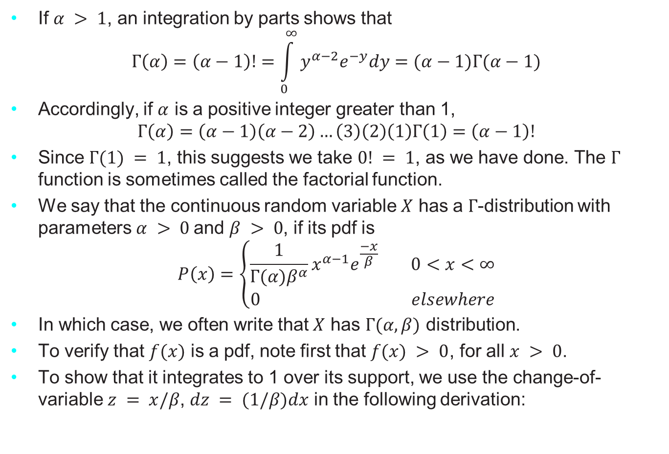
The Gamma ($Γ$) Distribution
If $α > 1$, an integration by parts shows that
$$Γ\left(α\right)=\left(α−1\right)!=\int_{0}^{∞}{y^{α−2}e^{−y}dy}=(α−1)Γ(α−1)$$
Accordingly, if $α$ is a positive integer greater than 1,
$$Γ\left(α\right)=\left(α−1\right)\left(α−2\right)…\left(3\right)\left(2\right)\left(1\right)Γ\left(1\right)=\left(α−1\right)!$$
Since $Γ(1) = 1$, this suggests we take $0! = 1$, as we have done. The $Γ$ function is sometimes called the factorial function.
We say that the continuous random variable $X$ has a $Γ$-distribution with parameters $α > 0$and $β > 0$, if its pdf is
$$P\left(x\right)=\left\{\begin{aligned}\frac{1}{Γ(α)β^{α}}x^{α−1}e^{\frac{−x}{β}} 0<x<∞ \\ 0 elsewhere\end{aligned}\right.$$
In which case, we often write that $X$ has $Γ(α, β)$ distribution.
To verify that $f(x)$ is a pdf, note first that $f(x) > 0$, for all $x > 0$.
To show that it integrates to 1 over its support, we use the change-of-variable $z = x/β$, $dz = (1/β)dx$ in the following derivation:
Notes:
The genetic material that carries the instructions that allow cells to make proteins
Composed of a sugar phosphate backbone from which four nitrogenous bases- adenine (A), guanine (G), cytosine (C), and thymine (T) protrude
Arranged in a double helix- two strands are held together by specific pairings between bases A – T pair and G – C pair

Slide 22
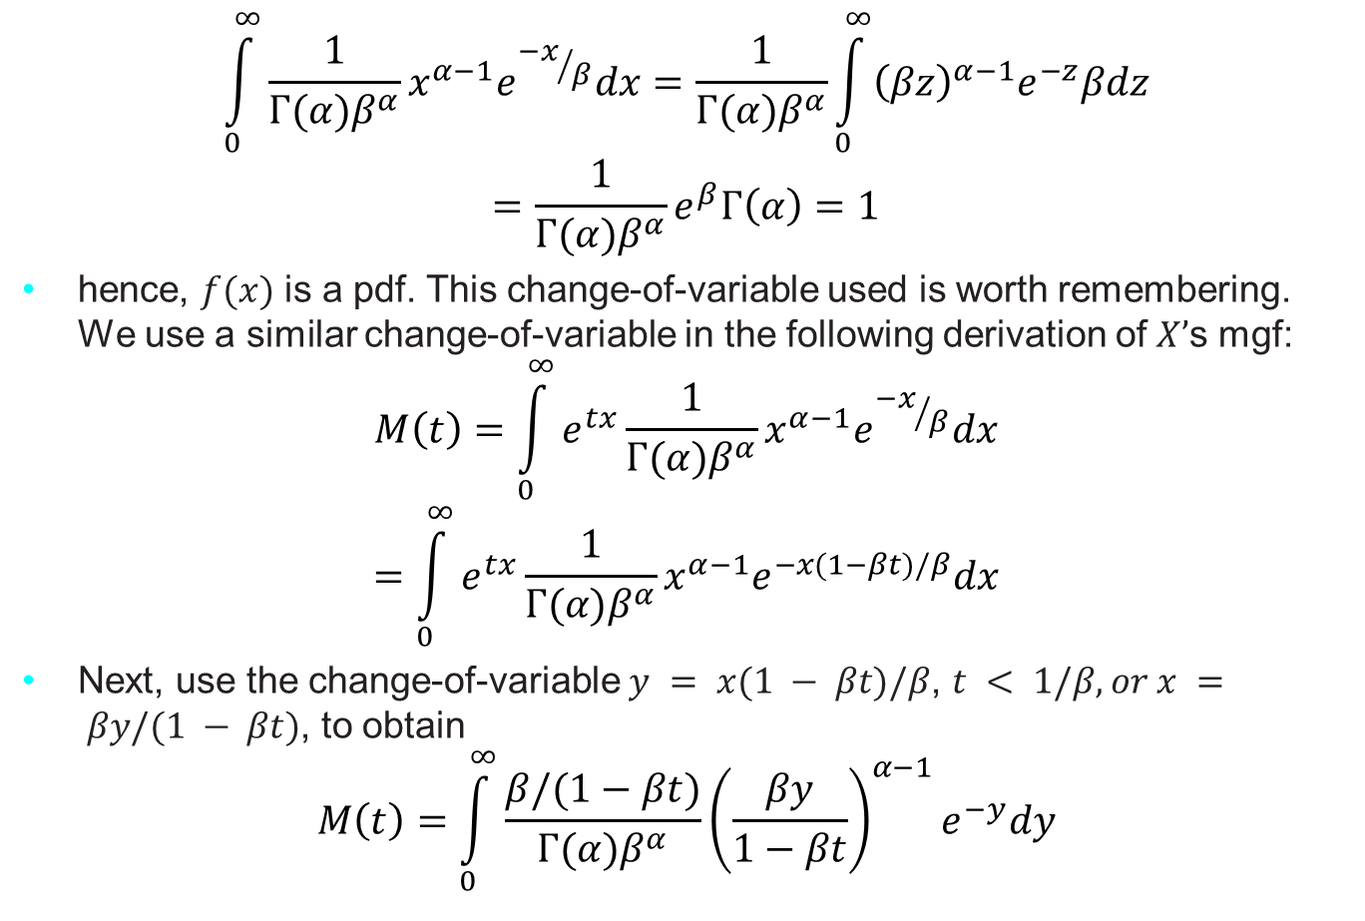
The Gamma ($Γ$) Distribution
$$\int_{0}^{∞}{\frac{1}{Γ(α)β^{α}}x^{α−1}e^{{−x}/β}dx=\frac{1}{Γ(α)β^{α}}\int_{0}^{∞}{{\left(βz\right)}^{α−1}e^{−z}βdz}}$$
$$=\frac{1}{Γ(α)β^{α}}e^{β}Γ\left(α\right)=1$$
hence, $f(x)$ is a pdf. This change-of-variable used is worth remembering. We use a similar change-of-variable in the following derivation of $X’$s mgf:
$$M\left(t\right)=\int_{0}^{∞}{e^{tx}\frac{1}{Γ(α)β^{α}}}x^{α−1}e^{{−x}/β}dx$$
$$=\int_{0}^{∞}{e^{tx}\frac{1}{Γ(α)β^{α}}}x^{α−1}e^{−x(1−βt)/β}dx$$
Next, use the change-of-variable $y = x(1 − βt)/β$, $t < 1/β, or x = βy/(1 − βt)$, to obtain
$$M\left(t\right)=\int_{0}^{∞}{\frac{β/(1−βt)}{Γ(α)β^{α}}}{\left(\frac{βy}{1−βt}\right)}^{α−1}e^{−y}dy$$
Notes:
The genetic material that carries the instructions that allow cells to make proteins
Composed of a sugar phosphate backbone from which four nitrogenous bases- adenine (A), guanine (G), cytosine (C), and thymine (T) protrude
Arranged in a double helix- two strands are held together by specific pairings between bases A – T pair and G – C pair

Slide 23
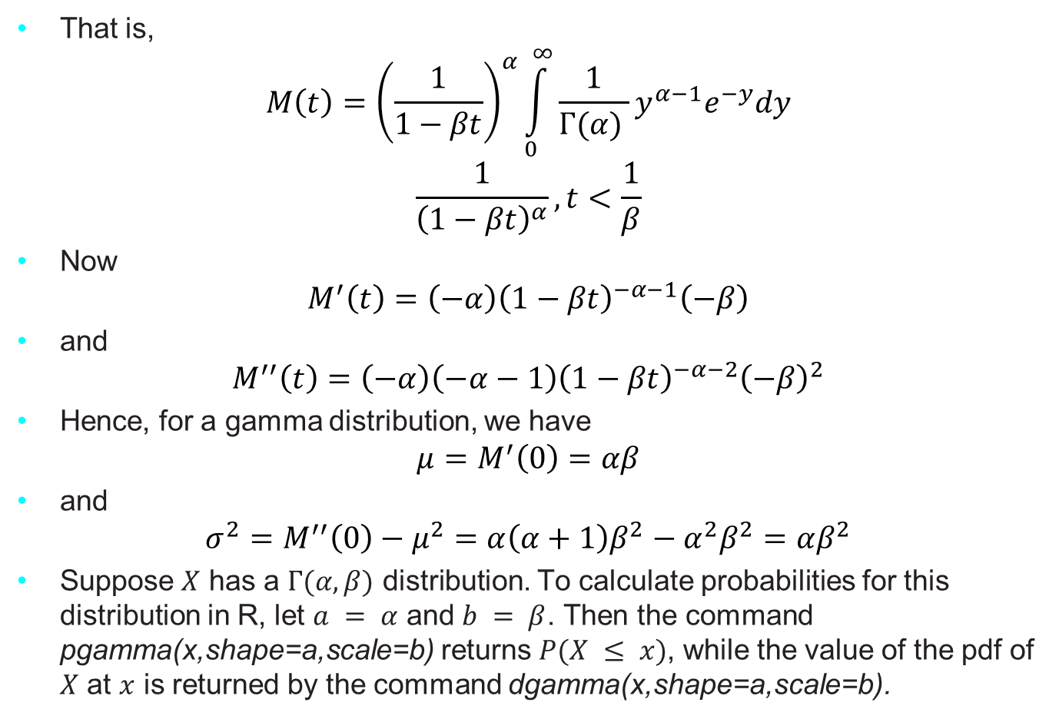
The Gamma ($Γ$) Distribution
That is,
$$M\left(t\right)={\left(\frac{1}{1−βt}\right)}^{α}\int_{0}^{∞}{\frac{1}{Γ(α) }}y^{α−1}e^{−y}dy$$
$$\frac{1}{{\left(1−βt\right)}^{α}}, t<\frac{1}{β}$$
Now
$$M^{′}\left(t\right)=\left(−α\right){\left(1−βt\right)}^{−α−1}\left(−β\right)$$
and
$$M^{′′}\left(t\right)=\left(−α\right)\left(−α−1\right){\left(1−βt\right)}^{−α−2}{\left(−β\right)}^{2}$$
Hence, for a gamma distribution, we have
$$μ=M^{′}\left(0\right)=αβ$$
and
$$σ^{2}=M^{′′}\left(0\right)−μ^{2}=α\left(α+1\right)β^{2}−α^{2}β^{2}=αβ^{2}$$
Suppose $X$ has a $Γ(α, β)$ distribution. To calculate probabilities for this distribution in R, let $a = α$ and $b = β$. Then the command pgamma(x,shape=a,scale=b) returns $P(X ≤ x)$, while the value of the pdf of $X$ at $x$ is returned by the command dgamma(x,shape=a,scale=b).
Notes:
The genetic material that carries the instructions that allow cells to make proteins
Composed of a sugar phosphate backbone from which four nitrogenous bases- adenine (A), guanine (G), cytosine (C), and thymine (T) protrude
Arranged in a double helix- two strands are held together by specific pairings between bases A – T pair and G – C pair

Slide 24
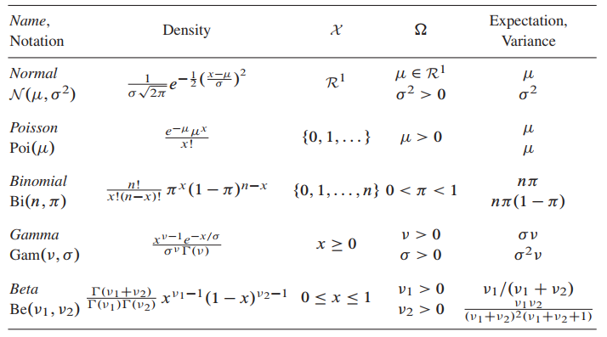

Univariate Families
Univariate parametric families, in which the sample space $χ$ of observation $x$ is a subset of the real line $ℛ^{1}$, are the building blocks of most statistical analyses.
Table below names and describes the five most familiar univariate families: normal, Poisson, binomial, gamma, and beta.
Notes:
The genetic material that carries the instructions that allow cells to make proteins
Composed of a sugar phosphate backbone from which four nitrogenous bases- adenine (A), guanine (G), cytosine (C), and thymine (T) protrude
Arranged in a double helix- two strands are held together by specific pairings between bases A – T pair and G – C pair

